Slide 1


FPDF is a PHP class Generate Result

Slide 2


Bootstrap Framework HTML & CSS Templates Responsive Website
Font Awesome icon toolkit
Bootstrap CDN

Slide 3

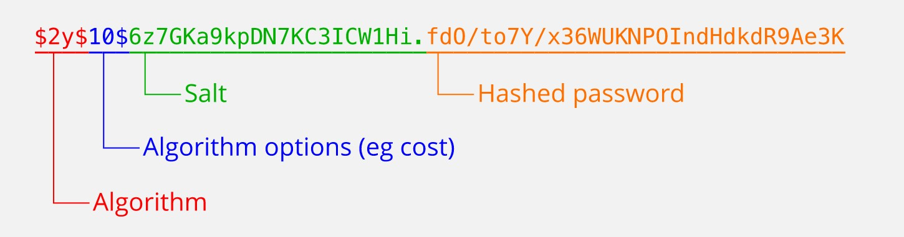
Encryption
Message-Digest Algorithm
Produce 128-bit hashed value
Not Reversible Function
Huge Number of Hash Database
1,154,870,188,082

Slide 4


Online Meeting
Schedule a Meeting Using Google Meet
Schedule a Meeting Using Zoom

Slide 5
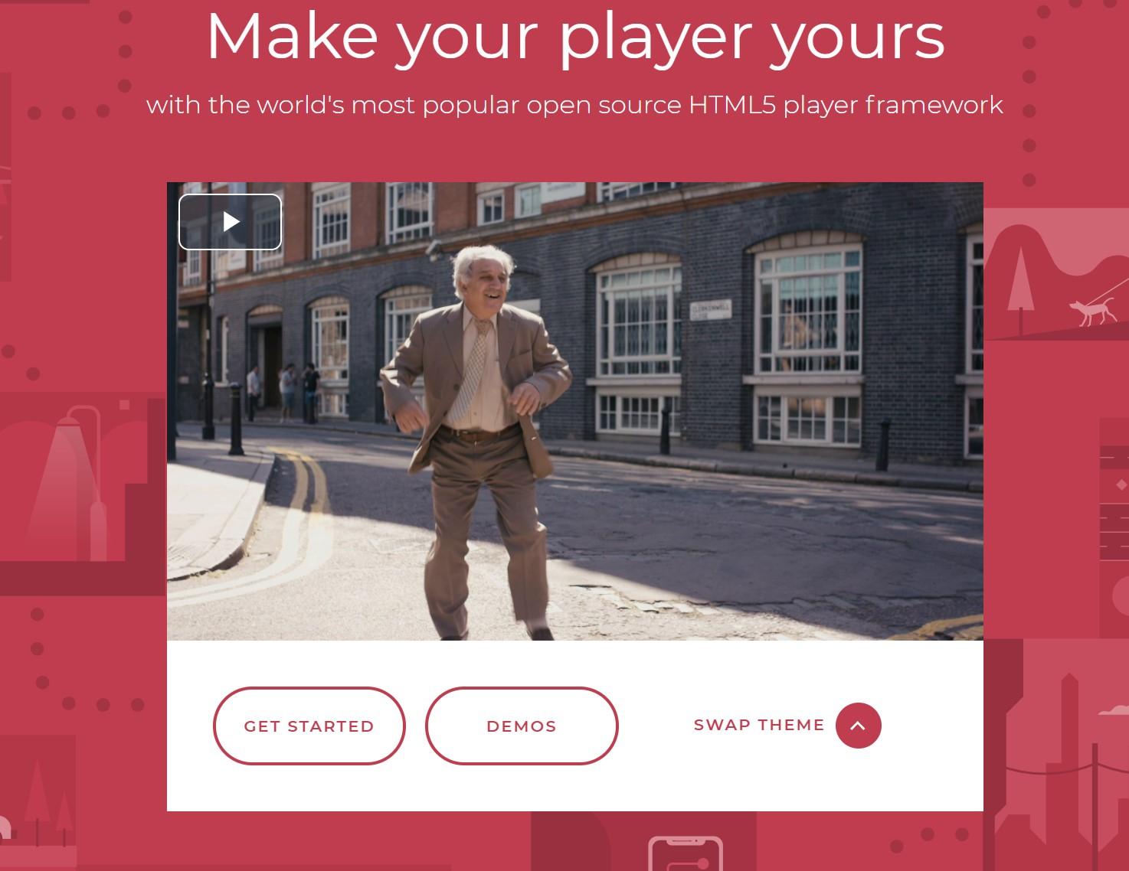
Video.js
Supports HTML5 video and Modern streaming
Easy Plugins install Chromecast, IMA
Play Any format Videos
Reliable and Consistant

Slide 6

Conclusion
Write here

